Slide 1
Full Stack Web Development
Node.js / Getting Started

Slide 2
What Is Node.js?
Long Answer: Node.js is a platform built on Chrome’s JavaScript runtime. It’s used to build fast, scalable network applications. It uses an event-driven, non-blocking I/O model that makes it lightweight and efficient, making it perfect for building real-time applications
Short Answer: JavaScript on the server

Slide 3
Asynchronous I/O
Does not need to wait for one process to finish before starting the other (Non-Blocking)
Optimizes throughput and scalability in web applications with many I/O operations
Event-Driven Programming
This makes Node.js apps extremely fast and efficient

Slide 4
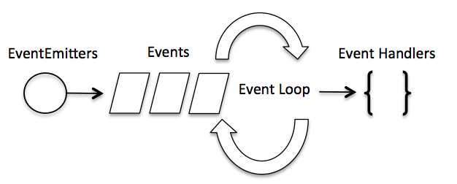
Event Loop
Single-threaded
Supports concurrency via events and callbacks
EventEmitter class is used to bind events and event listeners

Slide 5
Simple Example
var fs = require("fs");
fs.readFile('input.txt', function (err, data) {
if (err){
console.log(err.stack);
return;
}
console.log(data.toString());
});
console.log("Program Ended");

Slide 6
Platform Specifications
Available for Windows, Mac, Linux, Unix, SunOS
Comes as a binary installable
Available on both 32-bit and 64-bit architectures
Windows uses a simple MSI installer
REPL – Read, Eval, Print, Loop

Slide 7
NPM
Node Package Manager
Comes with Node.js v0.6.3+
Online repositories for node.js packages/modules
Installs into a “node_modules” folder
npm install express (add –g to install globally)
var express = require(‘express’);

Slide 8
Types Of Modules
Frameworks – Express.js
Template Engines – Pug, EJS, Handlebars
Utilities – Path, OS, API Modules, Compilers
Database ORM – Mongoose, MongoJS

Slide 9


